Slide 1
Arizona Management System Gone Virtual
October 15, 2020

Slide 2
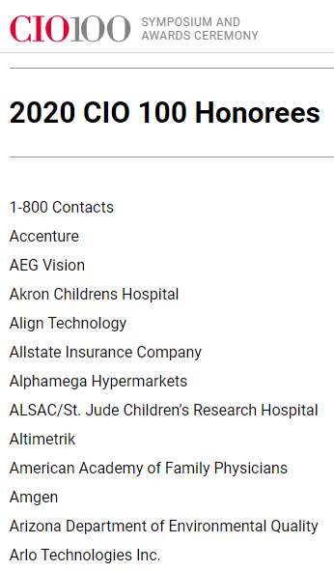
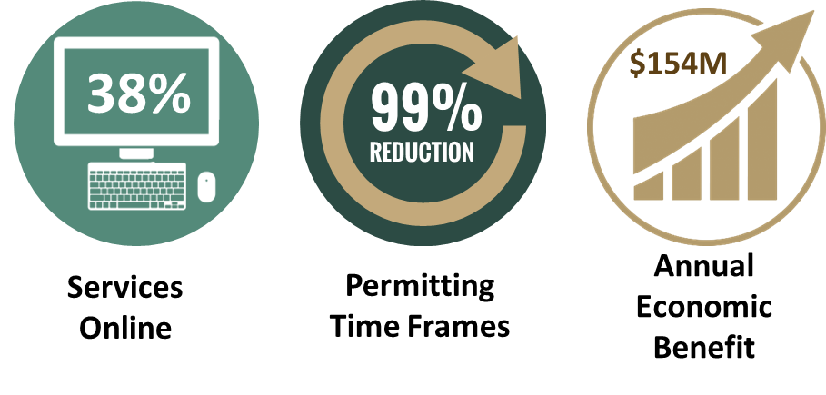
Award Winning Platform
Notes:
This slide addresses item 5 requested from the sub-committee. 1/2min
1. myDEQ is an online portal that provides a paperless option for the regulated community to obtain, modify, terminate permits/registrations and submit compliance reports to ADEQ.
The portal assists Arizona businesses by speeding up the permitting processes from several days/weeks to real-time, which eliminates the burden of paper permitting and compliance reporting on the regulated community.
25% (44) of the agency’s services to regulated entities are now available online
Permitting timeframes have been reduced by 99% to same day decision
The annual economic benefits using a calculator developed by Environmental Information Exchange Network (EIEN) for the completed 44 services is estimated at $145M
6. The My Community section of the website is designed to give the citizens of Arizona an easy-to-use way to look-up what environmental challenges and concerns are within their neighborhoods, around their children’s schools and community.

Slide 3
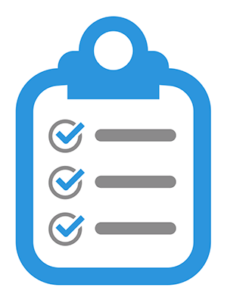
Management System Framework
performance and flow boards
Continuous
Improvement
problem solving events
tiered huddle meetings
+ business review
1:1
andon response
tiered gemba walks
staff development
Notes:
When we started our transformation 6 years ago we knew that we had to take a holistic approach.
Our current system has roughly 40 tools, training or practices.
The beautiful paradox is that you build a change-receptive culture by creating a holistic system that every manager follows strictly.

Slide 4
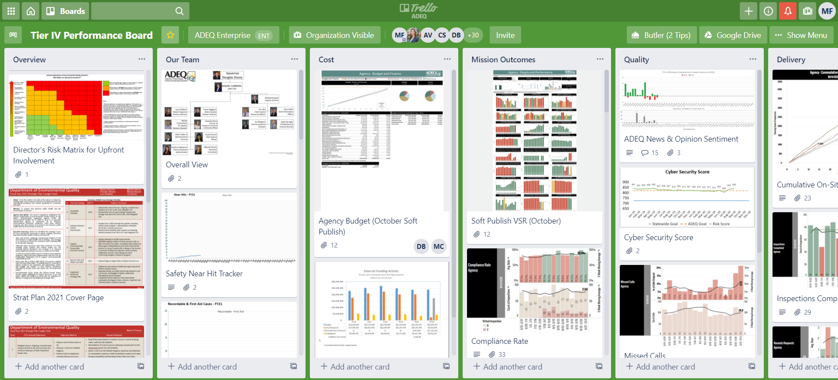
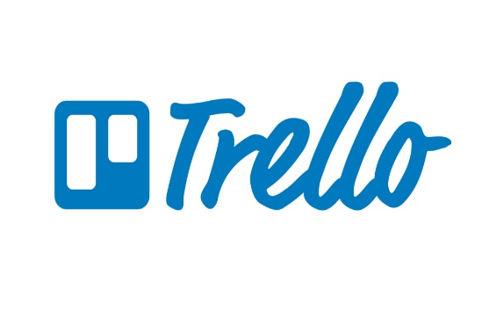
Virtual Performance Board

Slide 5
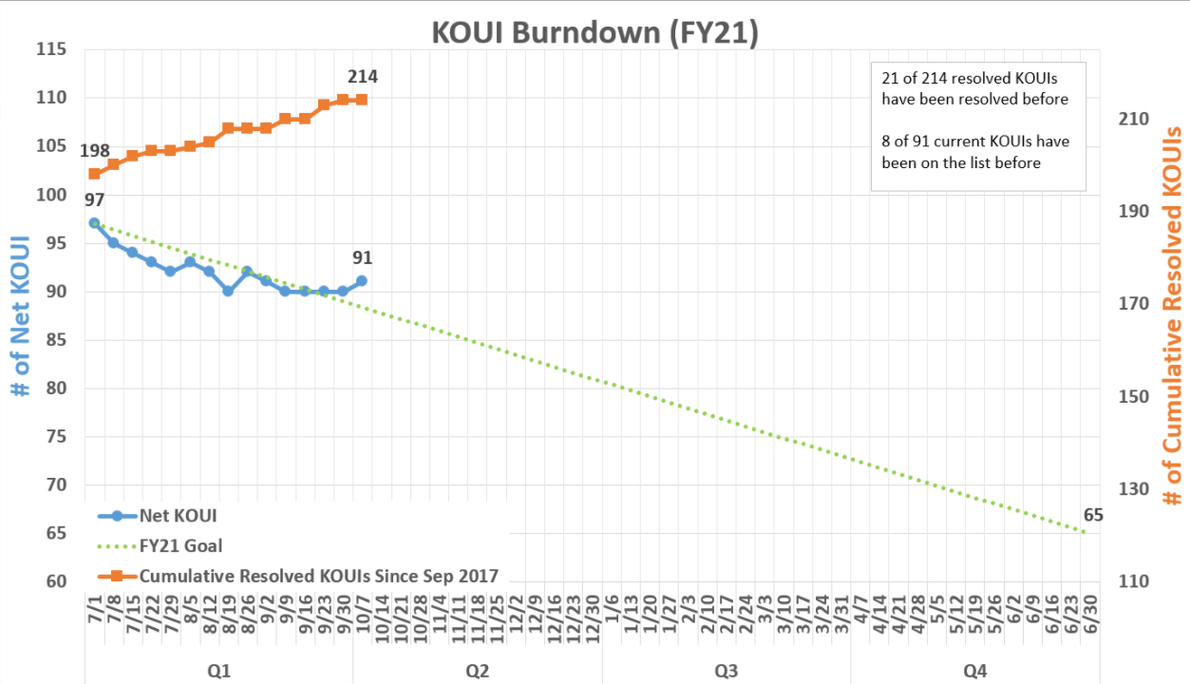
Virtual Performance Board Metrics

Slide 6
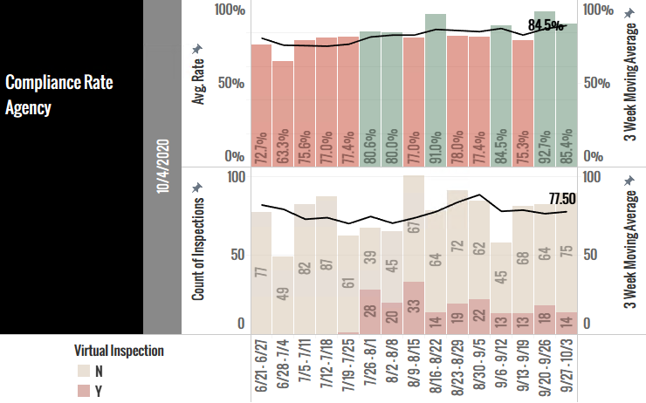
Virtual Performance Board Metrics (2)

